Slide 1
ESSIC Administrative, Financial and Technical Structure
IT Support & Communication
ESSIC Business Office
Account Managers
Procurement and Travel Office
Accounting
Proposal Submission
HR
ESSIC Front Office

Slide 2
ESSIC Administrative, Financial and Technical Structure
Business Office:
Travel, Procurement, Payroll,
Award Management, Proposal Development
Human Resources:
Faculty Affairs, New Hires, Fringe Benefits, Visa,
Contract, Letters of Employment
IT Support and Communication:
IT Procurement, Server Management,
Communication, IT Support
Front Office:
Building Maintenance, Keys,
Campus Parking Permits, Office Supplies

Slide 3
ESSIC BUSINESS OFFICE
HUMAN RESOURCES
PROPOSAL SUBMISSION
AWARD MANAGEMENT
ADMIN & ACCOUNTING SUPPORT
http://essic.umd.edu/ebo/

Slide 4
HUMAN RESOURCES
Assistant Director for HR: Sonja Junek sjunek@essic.umd.edu
Assistant Director: Andy Negri
anegri@essic.umd.edu
Coordinator: Linda Carter
lcarter@essic.umd.edu
Coordinator: Monica Gonsalves
rozarm02@essic.umd.edu

Slide 5
Human Resources
Main Contact: Sonja Junek
Faculty Affairs: APT process/Promotion/Title
Visa: H1B; J1; F1; Amendment, extensions
Appointment: Offer letters; Annual contracts; Letters of Employment; Problem Resolution
Benefits: Tuition Remission, Health, Retirement, Leave Policy

Slide 6
Human Resources
EMPLOYMENT VISAS
Presentation by Connie Jesse Lira

Slide 7
Employment Visas
Connie Jesse Lira, Assistant Director
International Student and Scholar Services

Slide 8
Criteria in ISSS Decision Making
Job Description/Activity
Salary
Title
Credentials
Length of activity
Notes:
Thank you for invitation
What are your specific questions that you would like for us to address during this presentation?
Note: HR handles the immigration processing for staff positions. They use Fragomen. Refer to “Price List”. Fees are confidential to UMCP.

Slide 9
F-1 and J-1 Student Employment
F-1 and J-1 Student Employment
F-1 Optional Practical Training – 12 months
F-1 STEM OPT – additional 17 months
J-1 Academic Training
Notes:
F-1
OPT for 12 months and in some cases STEM OPT for an additional 17 months
Good strategy for students to use this F-1 benefit at the completion of their program.
We use it to bridge people to J-1 or H-1B because of the processing times for these visa categories and departments do not give much lead time.
J-1 – Department of State Exchange Program – non-immigrant
UM applies for designation to hold the authority to issue the immigration documents in-house. UM holds the authority, responsibility and discretionary decision-making as the sponsor.
In some cases, carries the 2-year home residency requirement.
In Prof/Researcher category, carries a 24 month bar
Appropriate titles: FRA, RA and Visiting titles
Employment benefits by category = different process
Case example: J-1 visitor came to campus, checked-in and left to have a baby. Terminated J-1 and lost immigration status.
H-1
Go-to visa for employment
4th year, departments need to start thinking about PR if they wish to keep them.
O-1
Used in limited cases when H-1B runs out of time or Employee is subject to 212e

Slide 10
Employment Visas
J-1 – non-immigrant visa
Requires a B.A.
Appropriate for academic positions, lecturers, post-doctoral researcher, and all Visiting titles
Short-term scholar - maximum of 6 months
Research scholar – maximum of 5 years
No cost to the university
H-1 – dual intent employment visa
Requires a B.A. in a specialty occupation
Maximum length of 6 years
Appropriate for tenure-track/permanent positions

Slide 11
B-1/B-2 Visitor
Appropriate Activities:
Business Venture/Consult with business associates
Attend a scientific, educational, professional, or business convention, conference or workshop
Engage in independent research that will not benefit UMCP
Athlete
Lecture/Speaker (less than 9 days)
Access to services as a Guest

Slide 12
Latest Immigration Issues
Washington Alliance of Technology Workers v. DHS
U.S. District Judge Ellen Huvelle invalidated the federal regulation establishing the STEM OPT program on the ground that DHS had not followed the proper administrative process when it implemented the rule. The judge stayed the ruling and allowed the program to remain in place in the near term, granting DHS until February 12, 2016 to bring it into compliance with federal regulatory procedures. In doing so, Judge Huvelle made clear that she wanted to avoid hardship and disruption to F-1 STEM students and their employers.
STEM OPT regulation remains in place, allowing F-1 STEM students to seek an OPT extension and to work pursuant to an approved STEM OPT employment authorization document (EAD).
F-1 Students are being advised by ISSS to continue to apply for STEM OPT.

Slide 13
Questions?
Connie Jesse Lira
Assistant Director
International Student and Scholar Services
cjl@umd.edu
301-314-5823

Slide 14
PROPOSAL SUBMISSION
Proposal Coordinator: Scott Boutaugh
boutaugh@essic.umd.edu
Supported by Deb Baker for CICS Submissions

Slide 15
Proposal Submission
ESSIC FY2015 proposal submissions:
$61,717,980 submitted through 201 proposals
NASA: 40
NOAA: 13
NSF: 13
Others (USDA, DOE, ONR, PNNL, MSG, JPL, World Bank): 53
CICS: 29 bundles (82 tasks)

Slide 16
Proposal Submission Timeline, requirements
Proposal development to start 2–3 weeks prior to sponsor due date.
Budget, budget justification and abstract MUST be finalized at least 6 business days in advance of the due date.
Final Science/SOW is due no later than 3 business days prior to the sponsor due date.

Slide 17
AWARD MANAGEMENT
Account Managers
EBO Associate Director: Stefanie Drame
drame@essic.umd.edu
CICS Business Manager: Heather Mattern
hmattern@essic.umd.edu
NASA MG Coordinator: Carolyn Flowers
cflowers@essic.umd.edu

Slide 18
Award Management
CICS
Point of contact: Heather Mattern
POs; TARs; TESs; Financial Reporting; Payroll
NASA Master Grant
Point of contact: Carolyn Flowers
POs; TARs; TESs; Financial Reporting; Payroll
Other Grants and Contracts
Point of contact: Stefanie Drame
POs; TARs; TESs; Financial Reporting; Payroll

Slide 19
ADMIN & ACCOUNTING SUPPORT
Procurement Office: Cathy Holm and Donna Gray
POs, TARs and TESs
Accounting: Shirley Goff and Vivian Shi
Accounting, POs, TARs and TESs
Office Management: Rashida Bandy
Office Supplies, Keys, Bldg Maintenance, Campus Parking Permits
Front Desk: Yolande Ridore

Slide 20
NEW TRAVEL PROCESSES
Any questions related to travel (TES/TAR) or procurement, please contact your Account Manager to make an appointment
!!The Procurement Office will no longer be your first point of contact!!
New online EBO TES form
TESs to be dropped-off or mailed-in only – If questions, please make an appointment
TESs should be submitted within 2 weeks of your return, to the extent possible

Slide 21
New Travel Processes
TES package MUST include:
Driving Directions; Exchange Rate; Taped original receipts; Per Diem bfst/lunch/dinner on TES
TARs MUST be submitted at least 3 weeks in advance of departure date
International/Domestic communication costs: Allowable except Global Data Plans – requires business purpose justification at the time of the TAR.

Slide 22
BA CENTRAL
MUST login through VPN first (https://terpware.umd.edu/Windows/Package/2039)
Login (http://baws1.umd.edu/Dashboard)
Available reports to ESSIC employees only
CICS: Task-level reporting available
How to read your account reporting
Need access? Contact Jean La Fonta

Slide 25
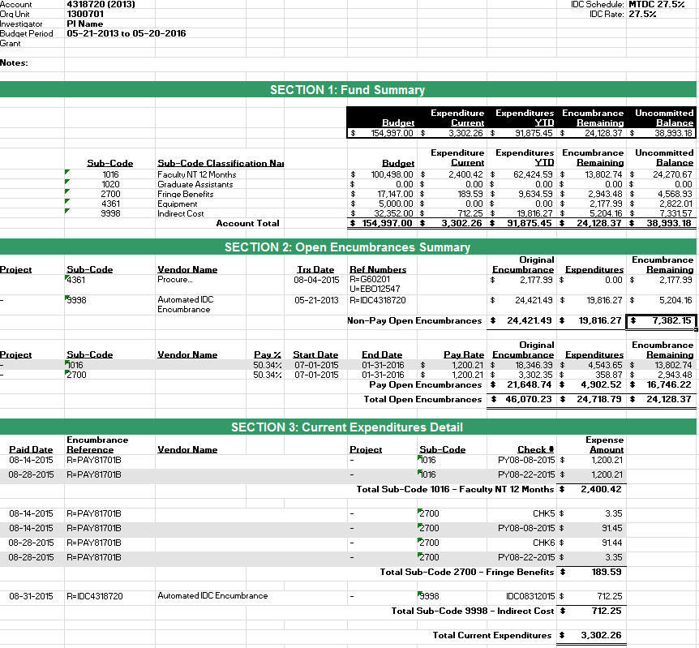

Slide 26
Q&A
EBO Contacts:
http://essic.umd.edu/ebo/contact.php
Upcoming Session:
Accessing and Using BA Central
Interpreting Financial Reports/Data

